Slide 1

Linux Security
(Some) Best Practices for Desktop & Server
By: Chris Trimble
Art By LILUG and OpenClipArt.org

Slide 2


What is Secure?
Who are you worried about?
What does your computer need to do?
What risks are you willing to take?

Slide 3
General Do’s & Don’ts
Do
Review your systems regularly
Update your software
Ask if features are being used (correctly)
Don’t
Set it and forget it
Give someone too much access
Test changes in “Production”

Slide 4


Have a “Business Continuity Plan”
Things to Consider:
Software vulnerability
Hardware failure
Travel

Slide 5
Making Linux More Secure
#!/bin/bash
# Loading up Security Tweaks…
echo ‘Configuring The Firewall:’

Slide 6
Configuring The Firewall:
IPTables is included in most systems
UFW is a simpler option based on IPTables
sudo ufw status
sudo ufw allow tcp/8001 comment “web app”
sudo ufw enable

Slide 7
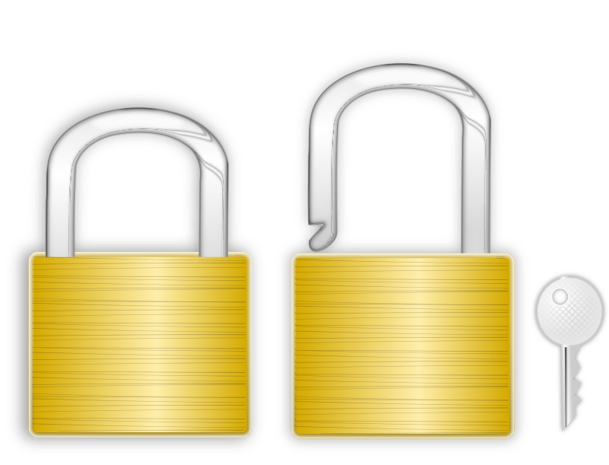
Secure your SSH Connections
Use keys, not passwords
Limit max connections
Use something like fail2ban

Slide 8
SELinux vs AppArmor
SELinux
File labels
Included on distros like Red Hat
(Usually) harder to configure
AppArmor
Paths/directories
Included in distros like Debian
Simpler but slightly slower
Limit what programs can access
Include notifications in logs when apps behave strangely

Slide 9

Automation
Updates:
  unattended-upgrades, dnf-automatic
Backups:
  Deja dup, (syncing to) Nextcloud
Configuration:
  Ansible, Bash, Timeshift

Slide 10

Further Reading
40 Linux Server Hardening Security Tips - Cyberciti
Securing Linux Servers - Suse

